Slide 1
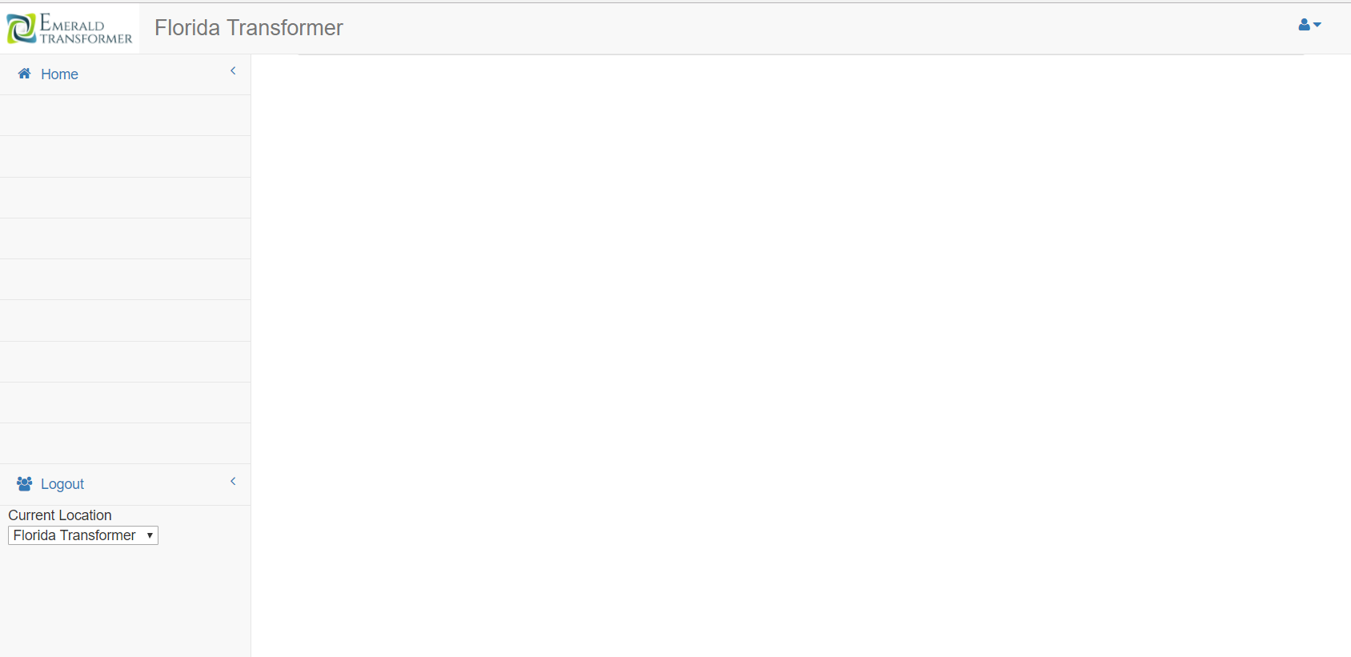



Injury Report > Report { - Filter Criteria }
Injury Report
 | Emerald FL | He said “ Hey Ya’ll watch this and the next thing he remembers was … | 01/01/2000
Injury
Location
Description
Date
30 or 90 or ALL
Report
Left Hand - Break
Injury Report Settings
We could move the Title up into the header. Since there is a lot of empty space there.
Page 1 of 8

Slide 2

Injury Report > Report Details – { Left Hand – Break }
Injury Report
Who:
Freak Accident
Requires Procedure Change
Report
Leg
Broken
Recordable?
Requires SOP Change
What:
Injury Report Settings
Who:
comments and or should new Personal Protective Equipment be added
When:
September
13
2011
Where:
EmeraldFL
Create / Edit Screen. View will be a similar layout without textboxes
EMS Dispatched
# Dialed:
911
Area:
In the back, beside the ramp
By Who:
Declined Medical
Hospital Required
At:
September
13
2011
Why:
Bob said that I couldn’t make the jump from the dock to the truck, but I knew that I could. It turns out that bob was right.
Save

Slide 3



1
Injury Report > Settings
Injury Report
Report
Site Location:
EmeraldAL
“EmeraldFL”
Question:
Could different sites have a separate injury listing requirements?
Injury Report Settings
Body Area:
Face
“Arm” or “Right Arm”
Settings Screen. View will be a similar layout without textboxes
Wound Type:
Swelling
“Laceration”
Future Conversation: Will they need more detail on the injury?
Wound Location:
cheek
“Elbow” or “Right Elbow”
Left Leg
Right Leg
Right Hand
Left Hand
Right Knee
Left Eye
Right Eye
Nose
Mouth
Laceration
Sprain
Bruise
Concussion
Pulled Muscle
Puncture
Burn
Severed Arm
Severed Leg
Hand
Finger
Elbow
Knee
Heel
Toe
Head
Forehead
Eye
Thought:
Should we display existing selections for Area/Type? Or validate the field against existing values
Save

